Slide 1
Erasmus+ Poetry workshop „My favourite gift“
„What‘s your Heritage-we are Yourope “

Slide 2
The pupils of the classes 6 and 8 had a project day where they wrote poems about their favourite gifts, out of about 70 poems the pupils of our school chose their favourite ones by giving points

Slide 3
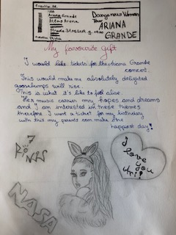
Here you can read the ten top voted ones

Slide 4
Poems….poems…

Slide 5
Poems about shoes and a puppy as a favourite gift

Slide 6
……and the last two ones…..

Slide 7
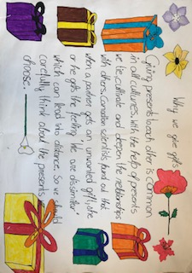
After the poetry workshop the pupils worked in groups about other occasions than the birthday when people give presents to each other……here are the results
(Kein Betreff)
Petar Ilic <petar_cili_fruits@icloud.com>
Heute, 20:02Sie
Von meinem iPhone gesendet

Slide 8
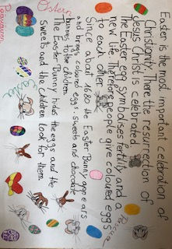
Occasions like Christmas or Easter…..

Slide 9
…..or Valentine‘s Day…..

Slide 10
The groups that were finished first drew gift wrapping papers

Slide 11
..and some more ….

Slide 12
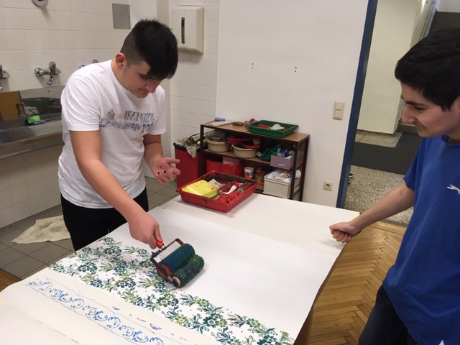
The gift wrap production was great fun….

Slide 13
Here you can see some results….

Slide 14
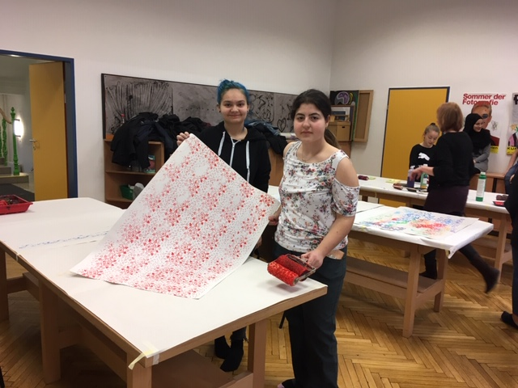
….and some more….

